Slide 1
Excel Reassessment

Slide 2
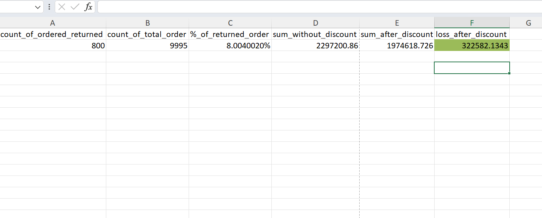
Q1
Formula used :- COUNTIF(Orders!V:V,"Yes")
=SUM(Orders!R:R)
Inference :- 8.004 % ordered got returned and loss happed due to discount is 322582.1343

Slide 3
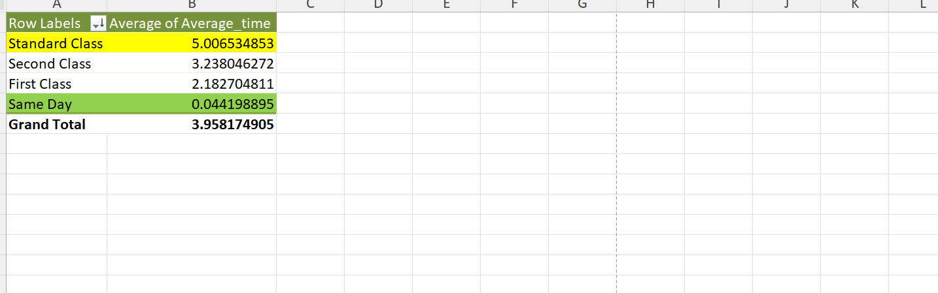
Q2
Formula used :- pivot table
Inference :-standard class has more average_time to shipment and same day less average time to shipment

Slide 4
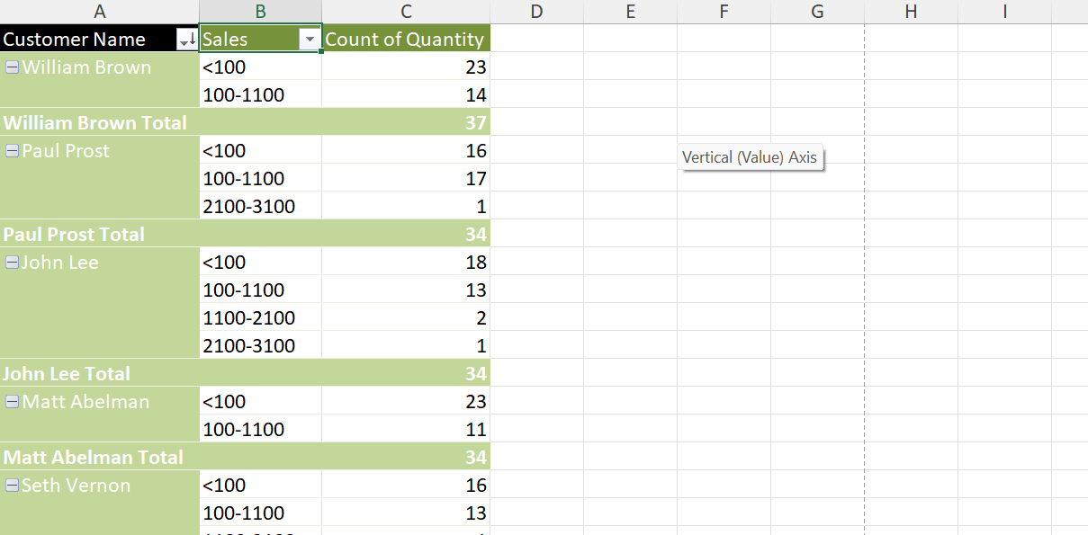
Q3
Formula Used:- Pivot table and its function
Inference :- In this we have grouped the sales amount to find the count of quantity of product for the customer to get to know about the product he shops more between the sales amount means to know how he spend his money.

Slide 5
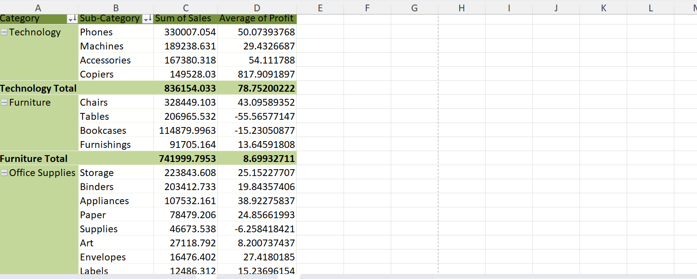
Q4
Formula used:- pivot table and its function
Inference :- Technology category has the highest sale and in that phone as sub category has the highest sale .and average of all the sub category are mentioned.

Slide 6
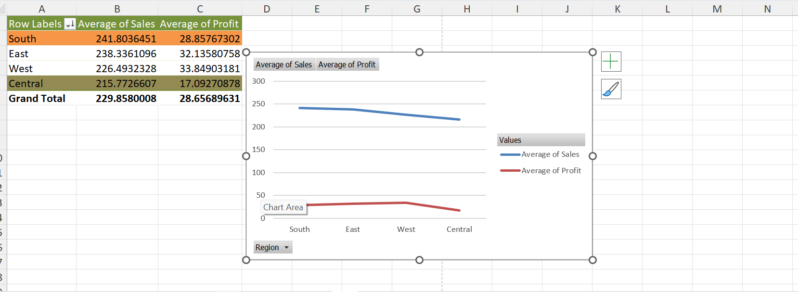
Q5
Formula used: Pivot table and its function
Inference:-From this we can see that the south region has the highest sale and central region has the lowest sale and from the graph we can infer the profitability is not dependent on the sale as west has less sale than south but the profit in west is more than south.

Slide 7
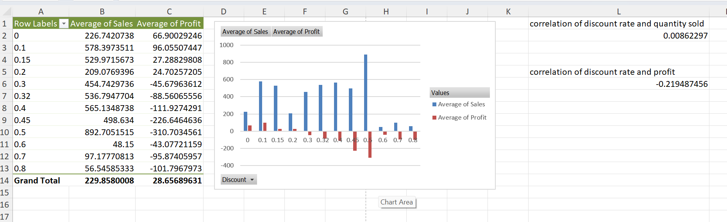
Q6
Formula Used:- =correl(array1,array2) and pivot table and its function
Inference :-here we can see that there is very less correlation between discount rate and quantity sold and there is negative relation ship between discount and profit
It mean somewhere discount can lead to more sale of quantity but the profit can not be taken out from that sale because of discount.

Slide 8
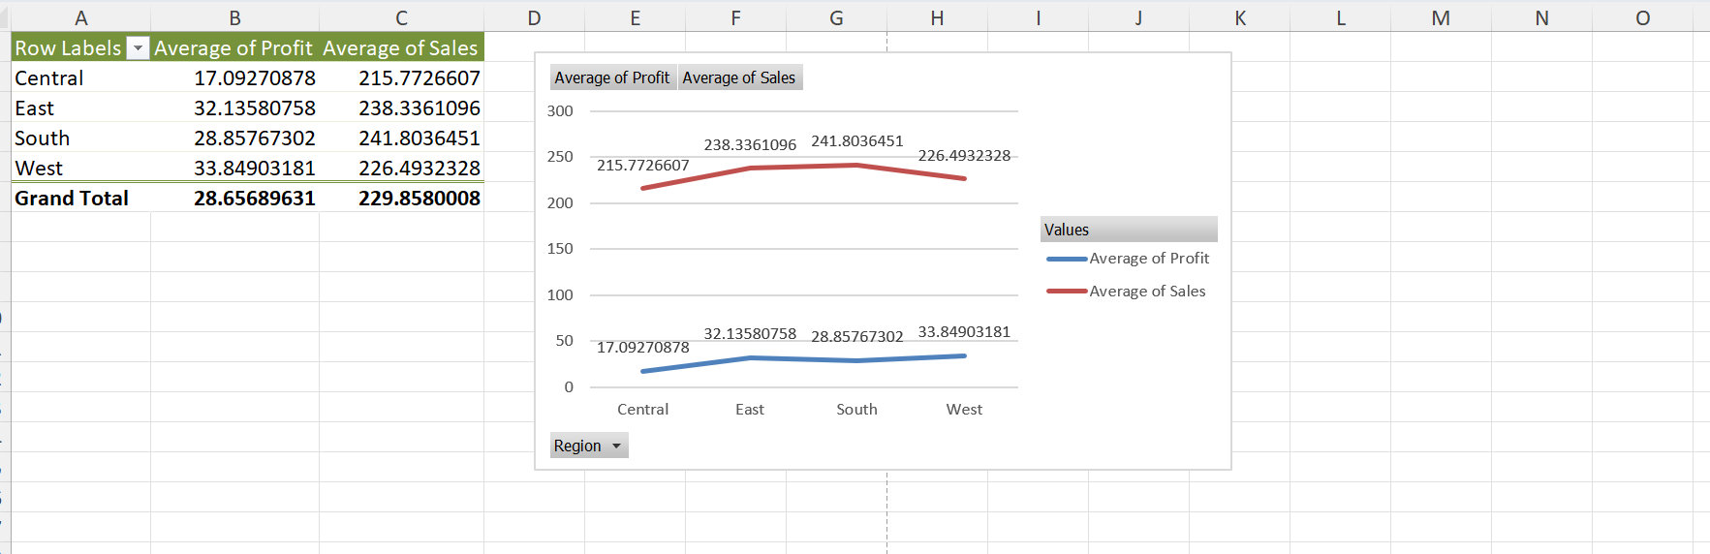
Q7
Formula :- pivot table and its function
Inference:-From this we can see that south has less profit but the sales are high and west have more profit but the sales are low so to penetrate the market with a new store we need to open our store in south region.

Slide 9
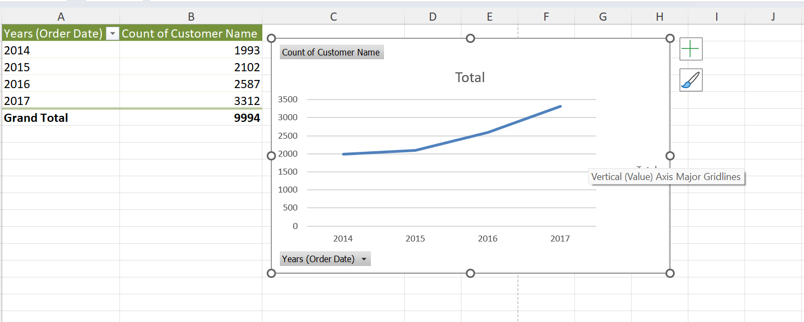
Q8
Formula Used:- Pivot table and its function
Inference :- From this we can say year on year customer are increasing it means the retention of customer are there and even new customer are also coming.

Slide 10
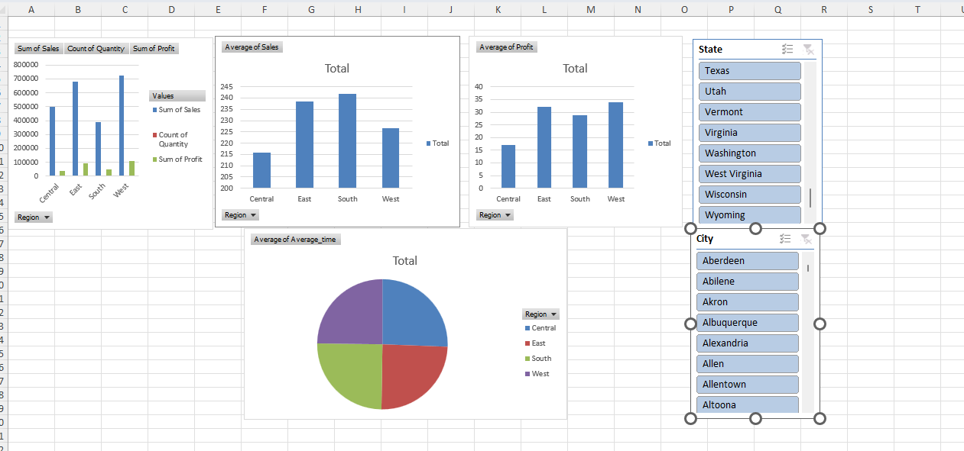
DASHBOARD
Q9
Formula USed: pivot table and it function
Inference:- Here I have created a dash board for the sales ,profit ,average_time ,on the region to get the knowledge of each region and I am using slicer for state and city to filter out the data according to the region of the state,city . We can determine from this about the city or states region and its sale,profit for that particular region so that we can take action to do as per the business needs.

Slide 11
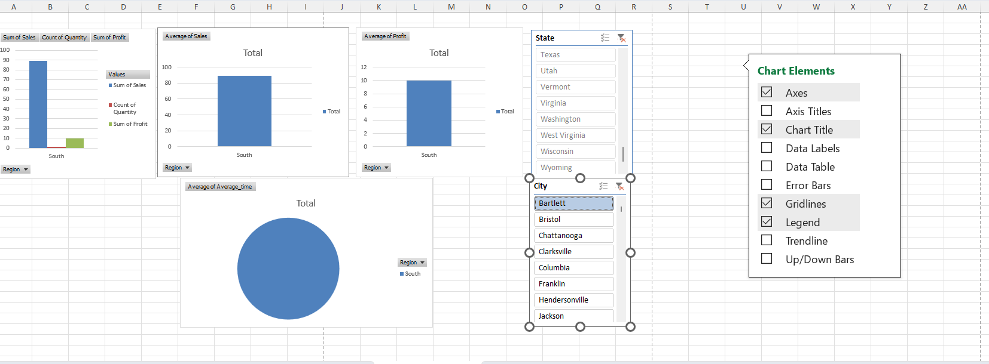
Dashboard is working .

